Slide 1
Literature Specific Chat bot
ECE 7500
Final Project Presentation
Jaideep Siva Senthil

Slide 2
Agenda
Background
Brief History of Chatbots
Motivation
Objective
Model Layout
LangChain
LLMs
Bloom
Methods
Relevant work
Future improvements
Conclusion
Citations

Slide 3

Background
A chat-bot in its essence simulates human conversation either through text or audio
Exponential increase in popularity and complexity driven by advancements in AI/ML
Integral part of everyday life with additions such as Siri, Alexa, Chat-GPT, etc.

Slide 4
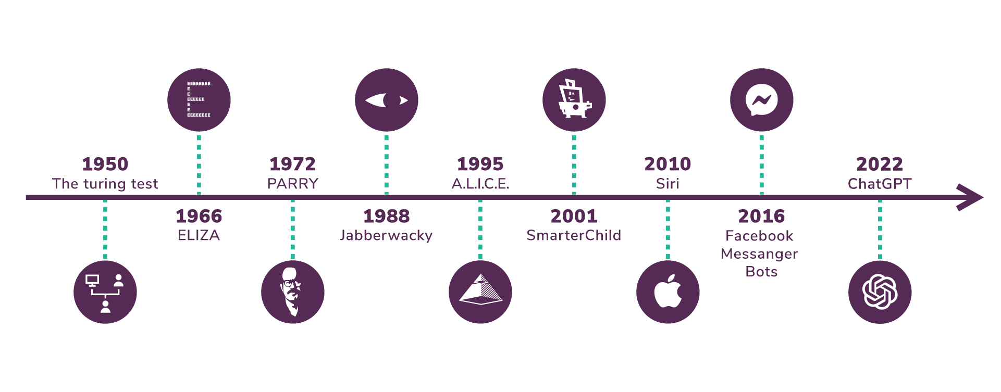
History of chatbots
1950s: Conceptual beginnings from Turing test to evaluate “intelligence” of machines.
1980s: Rule based chat bots.
2010s: Integration of some AIML into chatbots in form of Siri.
2020s: Advanced integration of NLP and integration into various industries.
Notes:
1950s-1960s: Early Beginnings
The conceptual groundwork for chatbots was laid in the 1950s and 1960s. The famous "Turing Test," proposed by Alan Turing in 1950, became a benchmark for evaluating a machine's ability to exhibit intelligent behavior indistinguishable from that of a human.
1960s-1970s: ELIZA
In the mid-1960s, Joseph Weizenbaum developed ELIZA, one of the first chatbots. ELIZA operated as a psychotherapist, engaging in text-based conversations that mimicked a Rogerian psychotherapist. Although relatively simple by today's standards, ELIZA sparked interest in the potential of conversational agents.
1980s-1990s: Rule-Based Systems
The 1980s and 1990s saw the development of rule-based chatbots. These systems operated on predefined sets of rules, and their responses were limited to specific keywords or patterns. While they lacked the sophistication of modern chatbots, they found applications in early online forums and messaging services.
2000s: Rise of Internet Chatbots
With the widespread adoption of the internet, chatbots began to play a more prominent role. Simple rule-based bots were integrated into websites and instant messaging platforms to provide basic information or assistance.
2010s: AI and Machine Learning Integration
The 2010s marked a turning point for chatbots with the integration of AI and machine learning technologies. This allowed chatbots to learn from user interactions, improving their ability to understand and respond to natural language. Platforms like Facebook Messenger and Slack introduced chatbot capabilities, and businesses started deploying them for customer support.
Present: Advanced NLP and Personalization
Modern chatbots leverage advanced natural language processing (NLP) algorithms, allowing them to understand context, sentiment, and user intent more effectively. Chatbots have become integral to various industries, including customer service, healthcare, finance, and more.
Future: Integration with Emerging Technologies
Looking forward, chatbots are expected to integrate with emerging technologies such as virtual reality (VR) and augmented reality (AR). This integration aims to provide more immersive and interactive user experiences. Additionally, ongoing advancements in AI and machine learning will likely contribute to even more sophisticated and context-aware chatbot capabilities.

Slide 5

Motivation
Limitations on current chatbots
Pretrained models
Knowledge up to training timeline
Inherent biases
Verbosity
Lack of contextual awareness
Personal reason- often incorrect answers for novel and specialized topics
Create a chatbot that acts as an assistant through the learning process
Notes:
a)Cultural and Linguistic Bias: Since ChatGPT is trained on data predominantly from the internet, it may be biased towards certain cultures, languages, or perspectives that are more prominently represented online. This can result in the AI model generating content that does not accurately reflect the diversity of human experiences or languages.
(b)Gender and Racial Bias: ChatGPT may unintentionally perpetuate gender and racial stereotypes due to biases in the training data. For example, the model may associate certain professions or roles with specific genders or ethnicities, reinforcing existing stereotypes.
(c)Bias in Content Recommendations: When used in recommendation systems, ChatGPT may exhibit biases by prioritizing content that aligns with a user's existing beliefs or preferences, potentially contributing to filter bubbles and polarization.
(d)Ideological Bias: ChatGPT may exhibit ideological bias, reflecting the dominant viewpoints or opinions found in its training data. This can lead to the generation of content that leans towards specific political, social, or economic ideologies, potentially reinforcing existing biases or creating an unbalanced representation of different perspectives.
Verbosity and Overuse of Certain Phrases: ChatGPT may sometimes produce verbose responses or overuse certain phrases, making the generated content appear repetitive or less natural.
Lack of Contextual Awareness: ChatGPT may sometimes generate content that lacks contextual awareness or fails to consider the broader implications of a given topic. This can result in content that appears superficial or does not account for the complexity of real-world situations.

Slide 6

Objective
Develop a domain-based question-answer chatbot leveraging Lang Chain, and existing large language models (LLMs) to assist users in extracting accurate answers from their documents

Slide 7
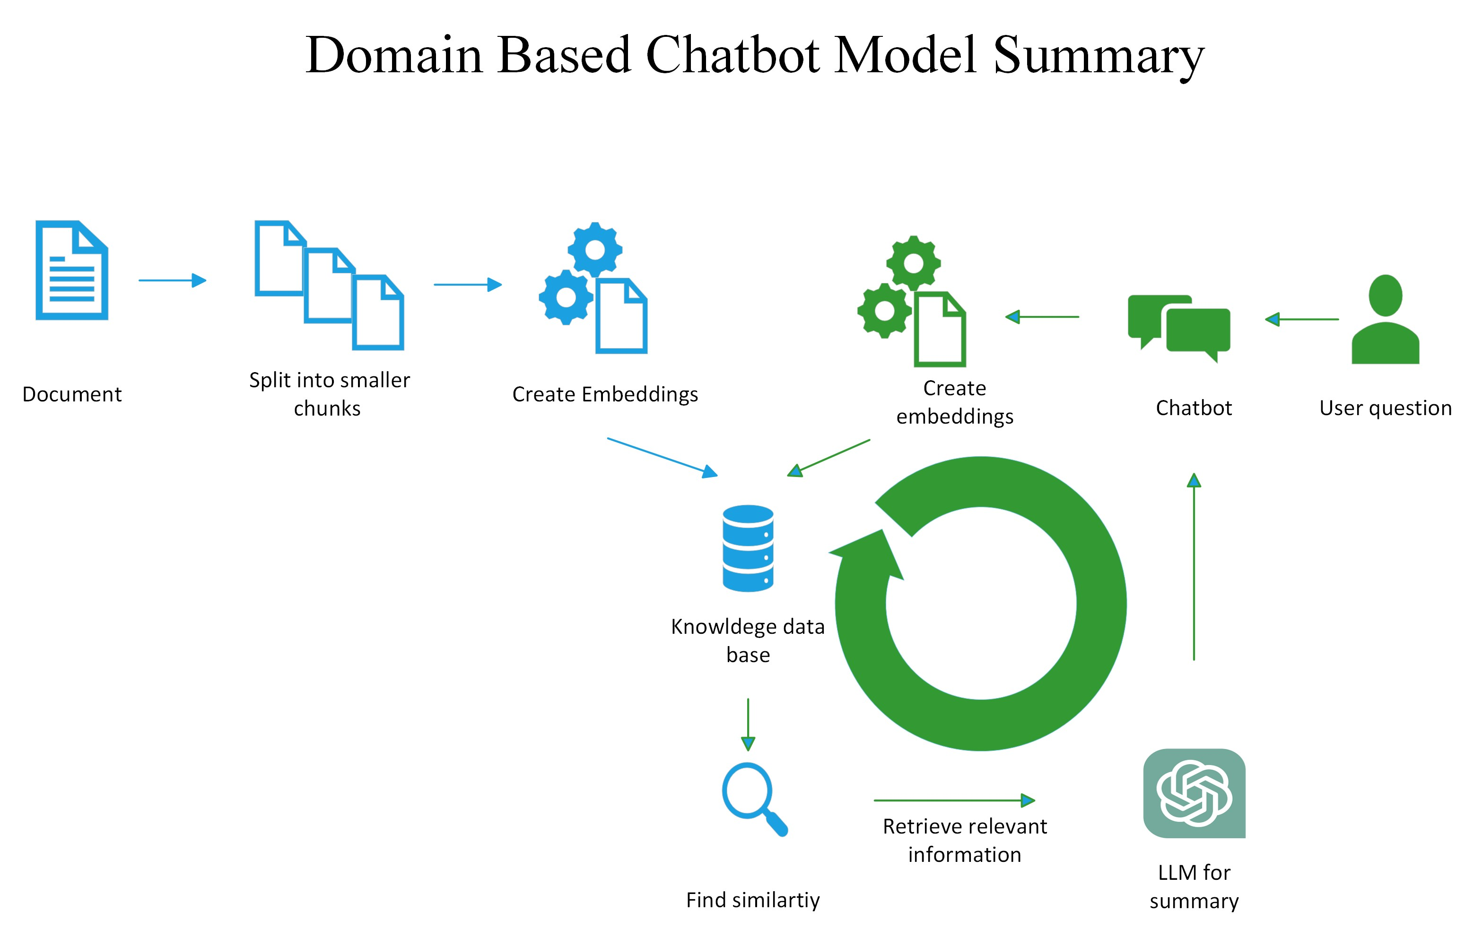

Slide 8
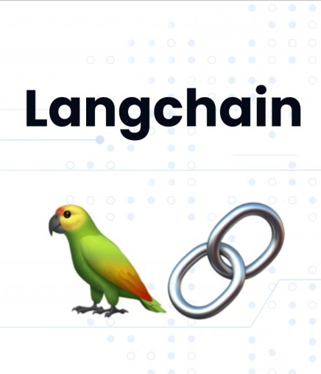
LangChain
LangChain is a framework for developing applications powered by large language models (LLMs)
Ease of use with predefined objects for text preprocessing
Opensource
Usability and optimization in terms of data cleaning, chunking, etc.

Slide 9
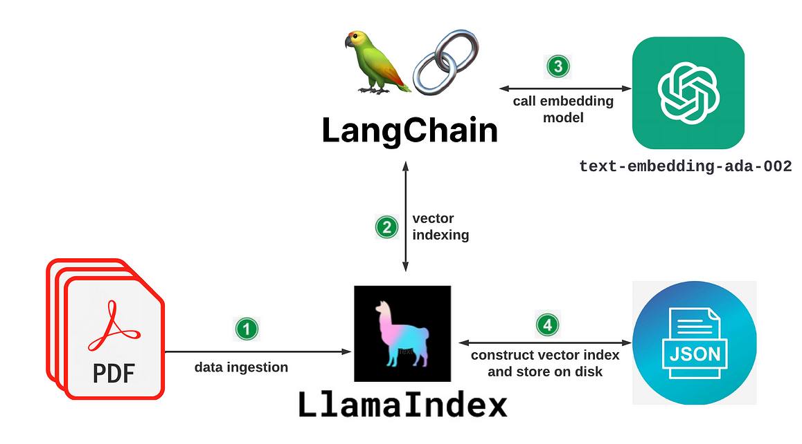
LangChain Uses
Document loader: For importing pdfs
Splitter : For splitting document into sizeable chunks
Pipeline: To create a processing pipeline for data
Storage: Embeddings storage for retrieval

Slide 10
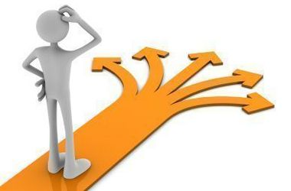
Choosing the right LLM
Domain of the document
Complexity of the information in the document
Depending on academic level of the user
Complexity of the LLM
The best LLMs might take too much time
Usability

Slide 11

Chosen LLM
Bloom (BigScience Large Open-science Open-access Multilingual Language Model)
Opensource
Compatibility:
Training focuses on scientific data
Training data includes multiple languages
Training data includes multiple code languages and math

Slide 12
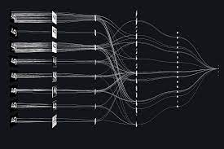
Bloom Architecture
Decoder-only transformers
Layer Normalization
ALiBi positional encodings with GeLU activation functions
7 Billion total parameters :
1,027,604,480 embedding parameters
30 layers, 32 attention heads
Hidden layers are 4096-dimensional
Sequence length of 2048 tokens

Slide 13
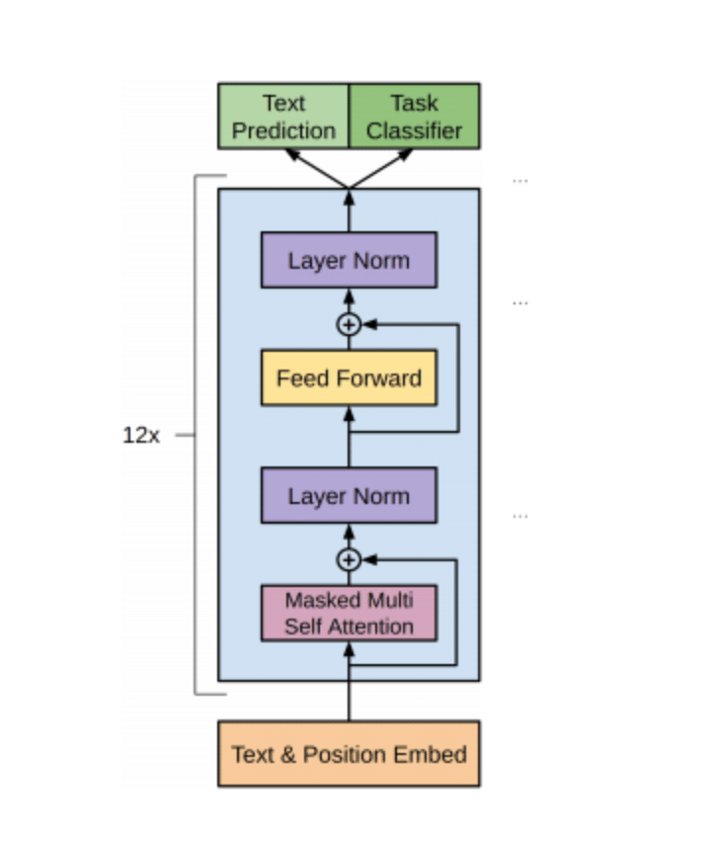
Decoder-Only
Transformer model where the only uses the decoder module for text prediction
Pros:
Faster
More creative
Cons:
Less Accurate
Less sensitive to context
Notes:
In natural language processing (NLP), a decoder-only architecture is a neural network architecture that consists solely of a decoder module. This architecture is in contrast to the more common encoder-decoder architecture, which consists of both an encoder and a decoder module.
The decoder module is responsible for generating an output sequence from an input sequence. It does this by iteratively predicting the next token in the output sequence, given the previous tokens in the output sequence and the input sequence. The decoder module can use a variety of mechanisms to generate the output sequence, such as self-attention, masking, and positional encoding.
Decoder-only architectures have been shown to be effective for a variety of NLP tasks, including machine translation, text summarization, and text generation. They are particularly well-suited for tasks that require generating creative or open-ended text formats.
Here are some of the advantages of decoder-only architectures:
Simplicity: Decoder-only architectures are simpler than encoder-decoder architectures, as they do not require an encoder module. This makes them easier to train and deploy.
Efficiency: Decoder-only architectures can be more efficient than encoder-decoder architectures, as they do not need to process the input sequence multiple times.
Creativity: Decoder-only architectures have been shown to be more creative than encoder-decoder architectures, as they are not limited by the input sequence.
Here are some of the disadvantages of decoder-only architectures:
Accuracy: Decoder-only architectures can be less accurate than encoder-decoder architectures, as they do not have the benefit of the encoder module.
Context: Decoder-only architectures can be less sensitive to context than encoder-decoder architectures, as they do not have the benefit of the encoder module.
Long inputs: Decoder-only architectures can struggle with long inputs, as they need to keep track of the entire input sequence.
Overall, decoder-only architectures are a promising new approach to NLP. They offer a number of advantages over encoder-decoder architectures, including simplicity, efficiency, and creativity. However, they also have some disadvantages, such as accuracy and context. As research in this area continues, we can expect to see decoder-only architectures become more widely used in a variety of NLP applications.

Slide 14
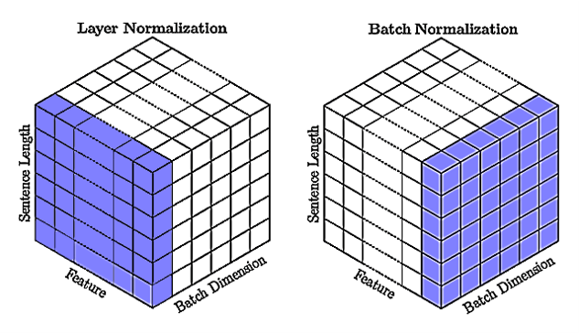
Layer Normalization
Normalization is applied to each inputs of layers
Pros:
Can handle varying batch sizes and lengths
Useful in NLP tasks
Cons:
Computationally intensive
Vanishing gradient
Notes:
Layer normalization is a normalization technique that is commonly used in deep learning models. It normalizes the activations of a layer by applying a transformation that maintains the mean activation within each example close to 0 and the activation standard deviation close to 1. This can help to improve the training and generalization performance of deep learning models.
Layer normalization was first introduced in the paper "Layer Normalization" by Jimmy Lei Ba, Jamie Ryan Kiros, and Geoffrey E. Hinton. The paper showed that layer normalization can improve the training and generalization performance of deep learning models on a variety of tasks.
Here is the formula for layer normalization:
x_i_normalized = gamma * (x_i - E[x_i]) / sqrt(Var[x_i] + epsilon) + beta
where:
x_i is the activation of the i-th neuron in the layer
x_i_normalized is the normalized activation of the i-th neuron in the layer
gamma is a scale parameter
beta is a bias parameter
E[x_i] is the mean activation of the i-th neuron in the layer
Var[x_i] is the variance activation of the i-th neuron in the layer
epsilon is a small constant that is added to the variance to prevent division by zero
Layer normalization is similar to batch normalization, but there are two key differences:
Batch normalization normalizes the activations of a layer across a batch of inputs.
Layer normalization normalizes the activations of a layer across the features of each input.
This means that layer normalization is independent of the batch size, while batch normalization is not. This makes layer normalization a good choice for tasks where the batch size is small.
Here are some of the advantages of layer normalization:
Improved training speed: Layer normalization can help to improve the training speed of deep learning models. This is because it can help to prevent internal covariate shift, which is a phenomenon that can occur in deep learning models and can make them difficult to train.
Better generalization: Layer normalization can help to improve the generalization performance of deep learning models. This is because it can help to reduce overfitting, which is a phenomenon that can occur in deep learning models and can make them perform poorly on unseen data.
Here are some of the disadvantages of layer normalization:
Increased computational cost: Layer normalization can increase the computational cost of deep learning models. This is because it requires additional computations to compute the mean and variance of the activations of each layer.
Reduced ability to learn long-range dependencies: Layer normalization can reduce the ability of deep learning models to learn long-range dependencies. This is because it normalizes the activations of each layer independently, which can break up long-range dependencies.
Overall, layer normalization is a powerful normalization technique that can improve the training and generalization performance of deep learning models. However, it is important to consider the increased computational cost and reduced ability to learn long-range dependencies when using layer normalization.
I hope this explanation is helpful. Please let me know if you have any other questions.

Slide 15
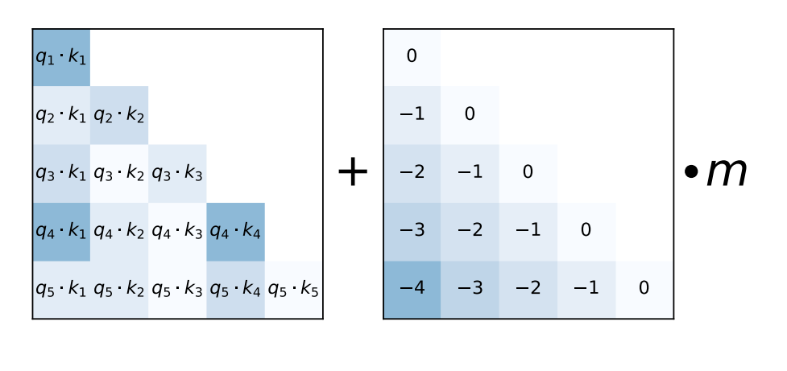
ALiBi Positional Encodings
Attention with Linear Biases improves transformer models by adding linear biases to attention scores
Pros:
Improved performance on long documents
More effective than other positional encoders
Cons:
Requires lot of tuning
Not good for general attention
Notes:
Attention with Linear Biases (ALiBi) is a positional encoding technique that aims to improve the performance of Transformer language models, particularly in long document processing tasks. It introduces linear biases to the attention scores in Transformer models, allowing them to process longer sequences without significant degradation in performance.
Transformer models, which are often used in natural language processing (NLP) tasks, rely on attention mechanisms to learn relationships between words in a sentence or document. However, standard attention mechanisms struggle to process long sequences, as the global attention mechanism that is typically used becomes more computationally expensive and more prone to overfitting as the sequence length increases.
ALiBi addresses this challenge by introducing linear biases to the attention scores. These biases are computed based on the relative positions of the query and key vectors in the attention mechanism. As a result, ALiBi penalizes the attention value that a query can assign to a key depending on how far away the key is. This effectively limits the range of attention, enabling Transformer models to process longer sequences without sacrificing performance.
ALiBi has been shown to be effective in improving the performance of Transformer models on a variety of NLP tasks, including machine translation, text summarization, and question answering. It has also been shown to be more efficient than other positional encoding techniques, such as sinusoid positional embeddings.
Here are some of the advantages of using ALiBi:
Improved performance on long document processing tasks
More efficient than other positional encoding techniques
Simpler to implement than other positional encoding techniques
Here are some of the disadvantages of using ALiBi:
Requires careful tuning of the linear bias parameters
May not be as effective for tasks that require global attention
Overall, ALiBi is a promising new positional encoding technique that has the potential to improve the performance of Transformer language models on a variety of NLP tasks, particularly those involving long sequences. It is a simple and efficient technique that has been shown to be effective in a number of studies. However, more research is needed to determine the full potential of ALiBi and to understand its limitations.
Here are some additional details about ALiBi:
ALiBi can be applied to both encoder-decoder and decoder-only Transformer models.
ALiBi can be implemented using a variety of methods, including adding the linear biases to the attention scores, modifying the attention query or key vectors, or using a separate module to compute the linear biases.
The linear bias parameters can be learned during training or set manually.

Slide 16
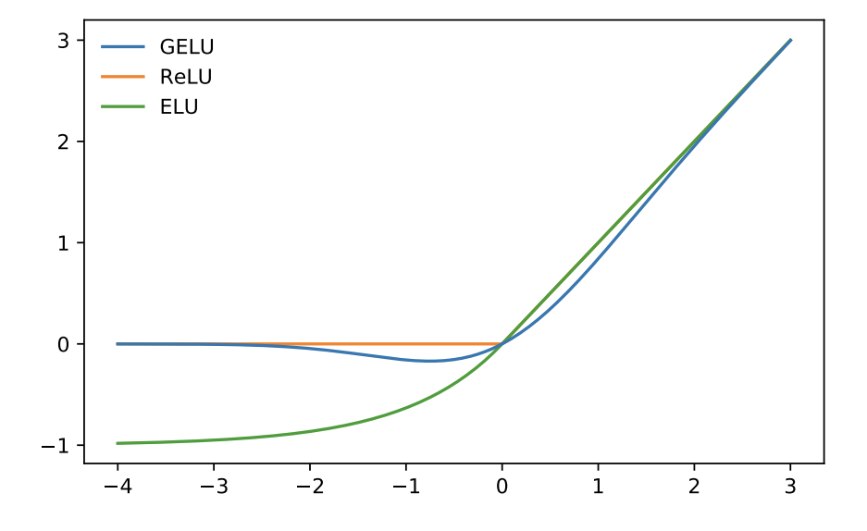
GelU activation function
Gaussian Error Linear Unit
Activation function which uses the gaussian cumulative distribution function
Pros:
Faster convergence
Reduced overfitting
Cons:
Computationally intensive
Notes:
Sure, I can explain GelU activation functions.
What is GelU?
GelU, or Gaussian Error Linear Unit, is a relatively new activation function that has been shown to outperform traditional activation functions such as ReLU and ELU in a variety of deep learning tasks. It is defined as the product of an input variable and the cumulative distribution function (CDF) of the standard normal distribution.
Formula:
GelU(x) = x * 0.5 * (1.0 + tf.tanh( (math.sqrt(2 / math.pi) * (x + 0.044715 * tf.pow(x, 3)))))
Properties:
Smoothness: GelU is a smooth activation function, meaning that its derivative is well-defined and continuous. This makes it less prone to vanishing gradients and exploding gradients, which can occur with other activation functions such as ReLU.
Non-monotonicity: GelU is a non-monotonic activation function, meaning that it does not always increase or decrease with its input. This can help the network to learn more complex patterns, as it allows the network to model relationships between inputs that are not always positive or negative.
Benefits:
Improved performance: GelU has been shown to improve the performance of deep learning models on a variety of tasks, including natural language processing, image recognition, and machine translation.
Faster convergence: GelU can help deep learning models to converge faster, meaning that they can be trained in less time.
Reduced overfitting: GelU can help to reduce overfitting, which is a problem that can occur when a deep learning model learns the training data too well and does not generalize well to new data.
Drawbacks:
Computational cost: GelU is slightly more computationally expensive than other activation functions such as ReLU.
Newer: GelU is a newer activation function, and there is not as much research on it as there is on older activation functions.
Overall, GelU is a promising new activation function that has the potential to improve the performance of deep learning models. It is a smooth, non-monotonic activation function that has been shown to improve performance, speed up convergence, and reduce overfitting. However, it is slightly more computationally expensive than other activation functions, and there is not as much research on it as there is on older activation functions.

Slide 17
Error Metrics
Perplexity
Cross Entropy loss
Both are most used metrics for language models

Slide 18
Other LLMs to consider
Llama 7b
Llama 13b
Falcon 180-b
One of the best performing LLMs for text generation
Wizard
For math and logic tasks

Slide 19

Data Preprocessing/ Embedding
Bloom tokenizer
A byte-level Byte Pair Encoding (BPE) algorithm
A simple pre-tokenization rule, no normalization
Minimal text preprocessing to retain more information about the document such as formulas, notations, etc.

Slide 20
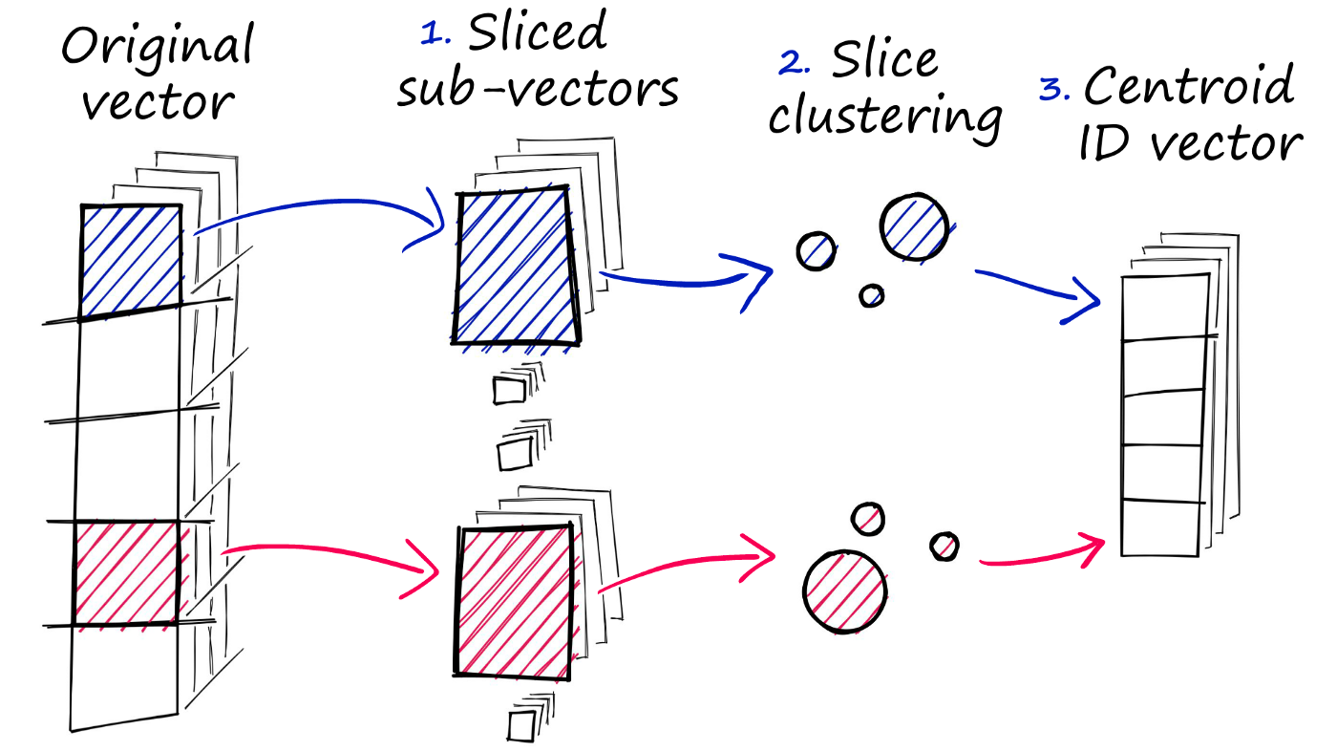
FAISS vector Storage
Facebook AI similarity search
Library that allows to quickly find similarity between documents
Returns k closest queries
Pros:
Accurate
User friendly
Cons:
Computationally intensive

Slide 21
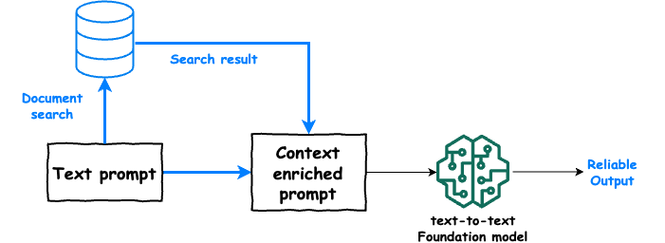
RAG ( Retrieval Augmented Generation)
“Open book exam”
Retrieval phase
Generation phase
Useful for knowledge intensive tasks
Eases the need to constantly train large models

Slide 22
Relevant Work
Introduces a novel approach named Retrieval-Augmented Generation (RAG) to enhance language models by combining pre-trained parametric and non-parametric memory.
This study explores two variations of RAG:
RAG-Sequence, employs the same retrieved passages for the entire generated sequence.
RAG-Token, allows different passages to be used for each token during generation.
These tasks include open-domain question answering, abstractive question answering, Jeopardy question generation, and fact verification.
Notes:
The research introduces a novel approach named Retrieval-Augmented Generation (RAG) to enhance language models by combining pre-trained parametric and non-parametric memory. The parametric memory is represented by a pre-trained sequence-to-sequence (seq2seq) model, while the non-parametric memory is a dense vector index of Wikipedia accessed through a pre-trained neural retriever. This study explores two variations of RAG: one, RAG-Sequence, employs the same retrieved passages for the entire generated sequence, and the other, RAG-Token, allows different passages to be used for each token during generation.
The models are fine-tuned and evaluated across a diverse set of knowledge-intensive natural language processing (NLP) tasks. These tasks include open-domain question answering, abstractive question answering, Jeopardy question generation, and fact verification. The research finds that RAG models surpass the performance of parametric-only seq2seq models and task-specific architectures in certain tasks, highlighting the advantages of combining both parametric and non-parametric memory for knowledge-intensive applications.
The paper also addresses challenges associated with the interpretability of model decisions and the ability to update world knowledge. It emphasizes the limitations of existing pre-trained language models in accessing and precisely manipulating knowledge and introduces RAG as a solution to these limitations. Additionally, the study discusses the potential applications of RAG in tasks where access to external knowledge is crucial and demonstrates its effectiveness through state-of-the-art results in open-domain question answering and other related tasks.
In summary, the research introduces a versatile and effective approach, RAG, which combines different types of memory to improve language models' performance on knowledge-intensive NLP tasks. The experiments and results presented in the paper provide valuable insights into the capabilities of RAG and its potential impact on various real-world applications.

Slide 23
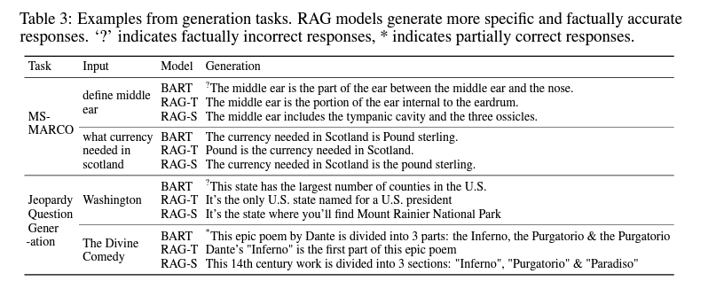
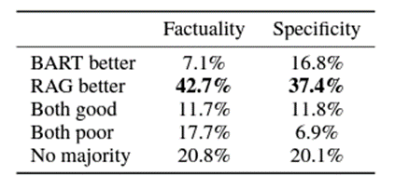
Relevant Work Cont.
Comparison in text generation for BART, RAG-T, and RAG-S

Slide 24
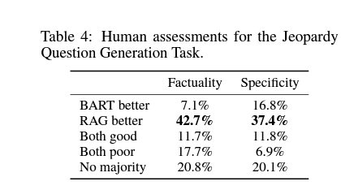
Relevant Work Cont.
Creating questions for a game of jeopardy
Outperforms existing models in domain specific knowledge
Users were asked to rate the factuality and the specificity of the generated sentences

Slide 25

RAG Pros
Higher contextual information
Better performing in domain specific information
Better handling of OOV / minimal hallucinations
Computationally less intensive compared to full LLM’s
Adaptability to different domains
Notes:
Rich Contextual Information: RAG systems can access vast amounts of external knowledge, enhancing language generation with real-world facts and context. This can lead to more informative, factual, and relevant responses.
Better Out-of-Distribution Performance: By retrieving information from external sources, RAG systems can handle out-of-distribution queries more effectively than traditional fine-tuned models. This is because they are not limited to the knowledge they were trained on, and they can incorporate new information as needed.
Reduced Training Data Dependency: Since RAG models rely on pre-trained language models, they require less fine-tuning data, which can be resource-intensive to obtain. This makes them more efficient and easier to train than traditional fine-tuned models.

Slide 26

RAG Cons
Added Complexity
Potential of increased bias based on documents
Limited creativity
Semantic Dependability
Notes:
Complexity: Implementing RAG systems involves managing both the generation model and retriever component, which can be more complex than standard fine-tuning approaches. This requires additional expertise and resources to develop and maintain.
Limited Creativity: RAG systems might be constrained by the retrieved information, limiting their creativity compared to fully generative models. This is because they are more likely to produce outputs that are similar to the retrieved documents.
Dependency on Semantic Search: The effectiveness of RAG is highly reliant on the quality of the semantic search. If the search retrieves irrelevant or low-quality documents, the generated responses may also be of poor quality.
Latency Issues: The two-step process of first retrieving documents and then generating responses can introduce latency. This might not be suitable for applications that require real-time responses.
Overall, retrieval-augmented generation is a promising new approach to natural language processing

Slide 27
Improvements and outlook
Addition to existing LLMs
Have document addition a part of current chatbots such as chat-gpt, bard, etc
Add Classification of user document
Based on the user document use the most appropriate LLM
Make an app or a webpage with UI
Make it more dynamic
Remembering the most asked question
Suggesting relevant information to study

Slide 28
Conclusion
The objective is to create a literature specific chatbot that aid the user by providing accurate answers about their document
Using RAG (Retrieval Augmented Generation) in tandem with LLM’s to create the most specific chatbot
Significance:
To create an assistive toolkit to aid in answering questions in more academically intensive and niche domains

Slide 29
References
S. Siriwardhana, R. Weerasekera, E. Wen, T. Kaluarachchi, R. Rana, and S. Nanayakkara, “Improving the domain adaptation of Retrieval Augmented Generation (RAG) models for open domain question answering,” Transactions of the Association for Computational Linguistics, vol. 11, pp. 1–17, Jan. 2023, doi: 10.1162/tacl_a_00530.
“Empowering domain adapted LLM’s.” https://www.arcee.ai/blog/the-pros-and-cons-of-retrieval-augmented-generation-and-fine-tuning-with-llms
P. Lewis, “Retrieval-Augmented Generation for Knowledge-Intensive NLP tasks,” arXiv.org, May 22, 2020. https://arxiv.org/abs/2005.11401v4
K. Martineau, “What is retrieval-augmented generation?,” IBM Research Blog, Oct. 20, 2023. https://research.ibm.com/blog/retrieval-augmented-generation-RAG
Press, Ofir, “Train Short, Test Long: Attention with Linear Biases Enables Input Length Extrapolation,” arXiv.org, Aug. 27, 2021. https://arxiv.org/abs/2108.12409v2
C. Mvs, “What is Decoder-only transformer model? | data-driven fiction,” Medium, Jun. 20, 2023. [Online]. Available: https://medium.com/data-driven-fiction/decoder-only-transformer-model-521ce97e47e2
Bigscience-Workshop, “GitHub - bigscience-workshop/bigscience: Central place for the engineering/scaling WG: documentation, SLURM scripts and logs, compute environment and data.,” GitHub. https://github.com/bigscience-workshop/bigscience/tree/master
“Introduction | ️🔗 Langchain.” https://python.langchain.com/docs/get_started/introduction
P. P. Ray, “ChatGPT: A comprehensive review on background, applications, key challenges, bias, ethics, limitations and future scope,” Internet of Things and Cyber-Physical Systems, vol. 3, pp. 121–154, Jan. 2023, doi: 10.1016/j.iotcps.2023.04.003.
“Retrieval Augmented Generation (RAG) - Amazon SageMaker.” https://docs.aws.amazon.com/sagemaker/latest/dg/jumpstart-foundation-models-customize-rag.html
“What is a Chatbot?” https://www.oracle.com/chatbots/what-is-a-chatbot/

Slide 30
Questions?

